Slide 1
SpaceClan JS group project
Group 2: Erik, Mike, Sumin, James
Notes:
Introduction: Good Afternoon, everyone. Today our group is going to talk about education app we design for our project.

Slide 2
Brief
MVP:
View educational contents on a topic (space solar system)
Interact with the page to move through different sections (e.g. explore/quizzes/statstics) of content
Extensions:
Use an API (NASA/French) to bring in content or a database to store information
Use charts or maps to display your information to the page
Target: BBC education department for improving their online offering of educational content by displaying some interactive browser applications
Notes:
(45s)

Slide 3
Planning
Understand the brief
Investigate Datasources
Constraint: data available
Formal planning:
Component diagrams/Wireframe
Trello
Notes:
(2m) So based on the brief, we as a group investigated data API and chose our topic based on the theme that gives a kind of good info. Project was initially constrained by the availablity of good quality of data. We then moved to formal planning, component diagrams, wireframes and Trello, sketch of the dataflow, which James is going to talk about in a few minutes

Slide 4
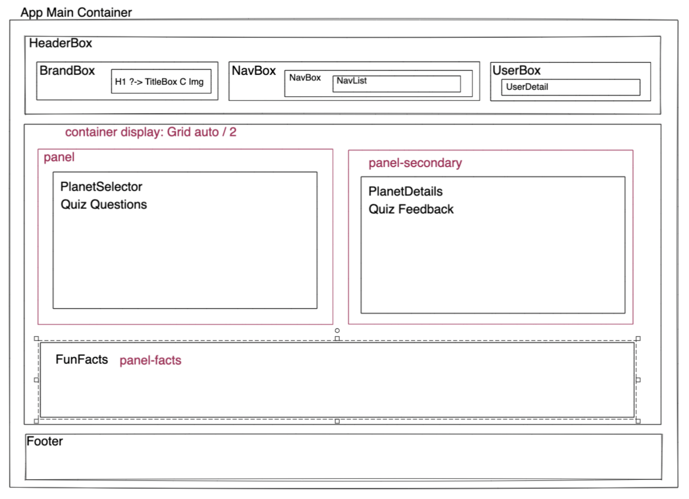
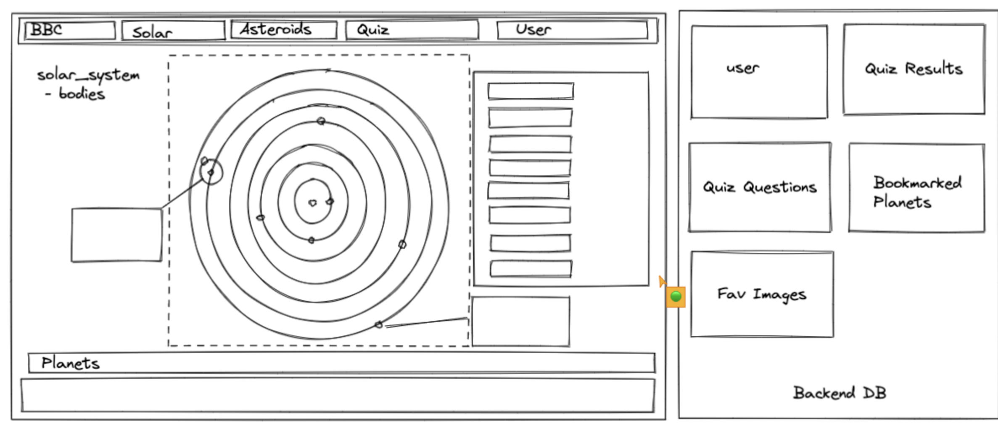
Component Diagram/initial wireframe

Slide 5
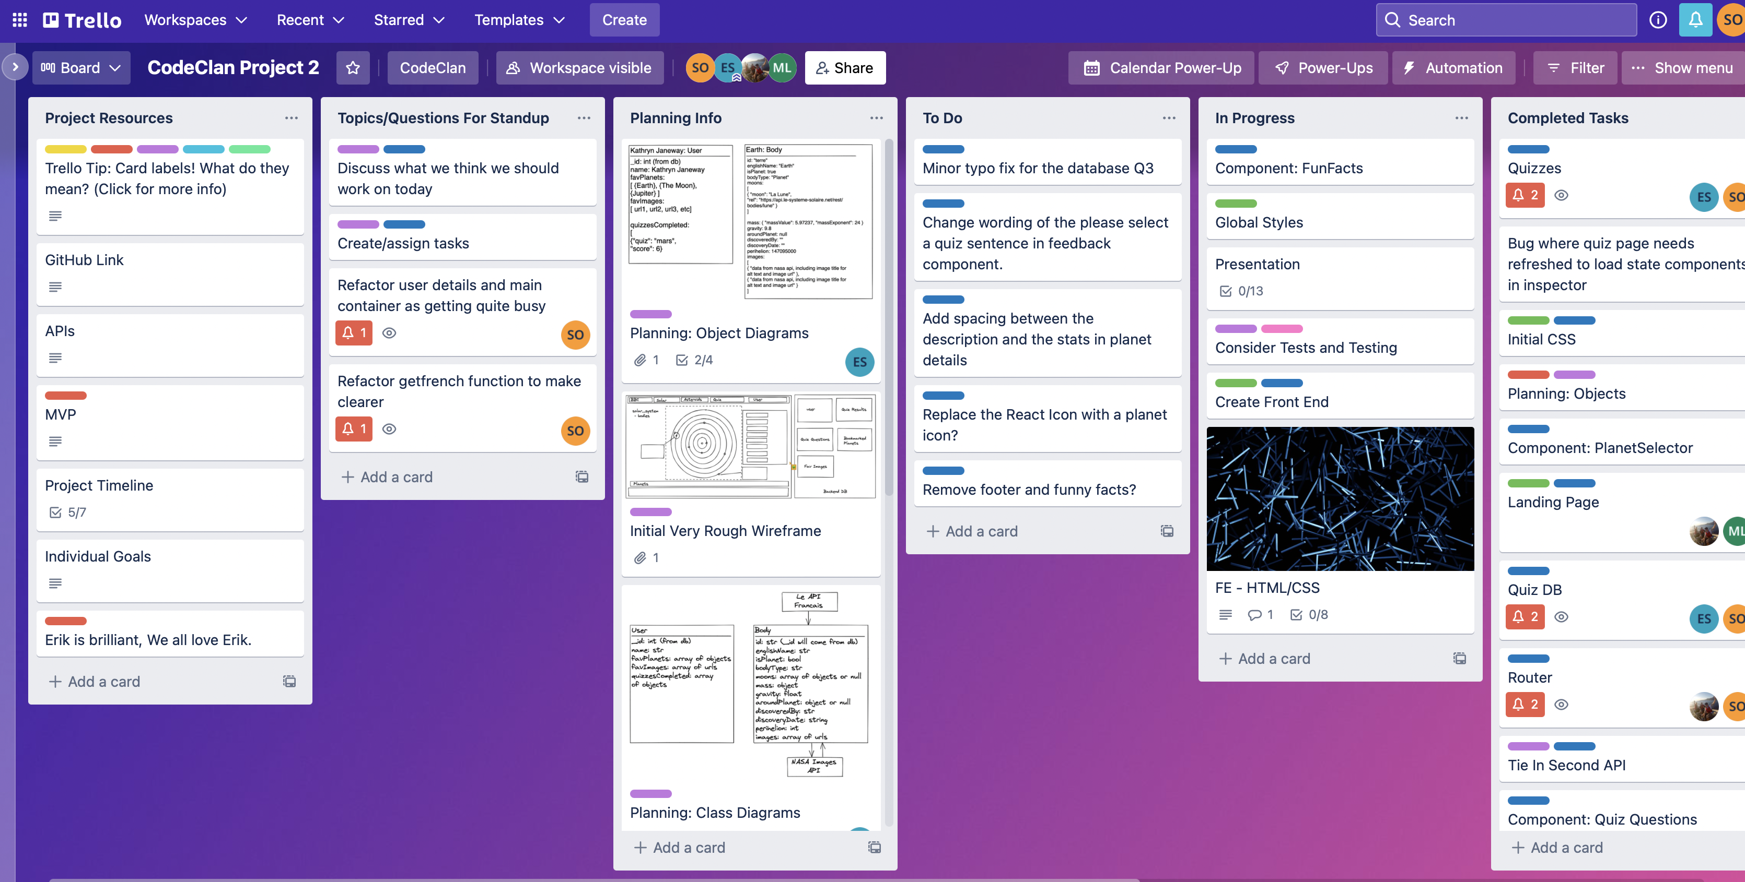
Trello Board on Day 2

Slide 6
Real World Planning with Agile
Once formal plan was made, it became Agile (e.g. meetings every morning and afternoon)
As our project progressed, some plans had changed
Stick to deadline / mvp done - avoided feature creep
Notes:
Once we understood our limited database/APIs, our plan adapted according to data available and our group understood task ahead.
We had a discussion every morning in addition to afternoon planning meetings to make sure we were all on the same page although some plans had changed, and this really helped us to avoid conflicts and feature creep and kept us all on target for our MVP to be done.

Slide 7
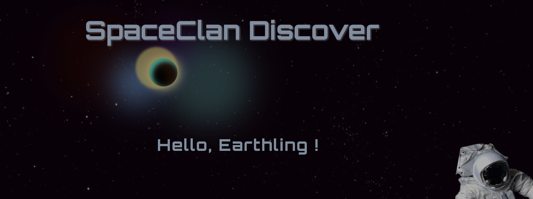
Would You Like To See It?
Notes:
(3m)

Slide 8
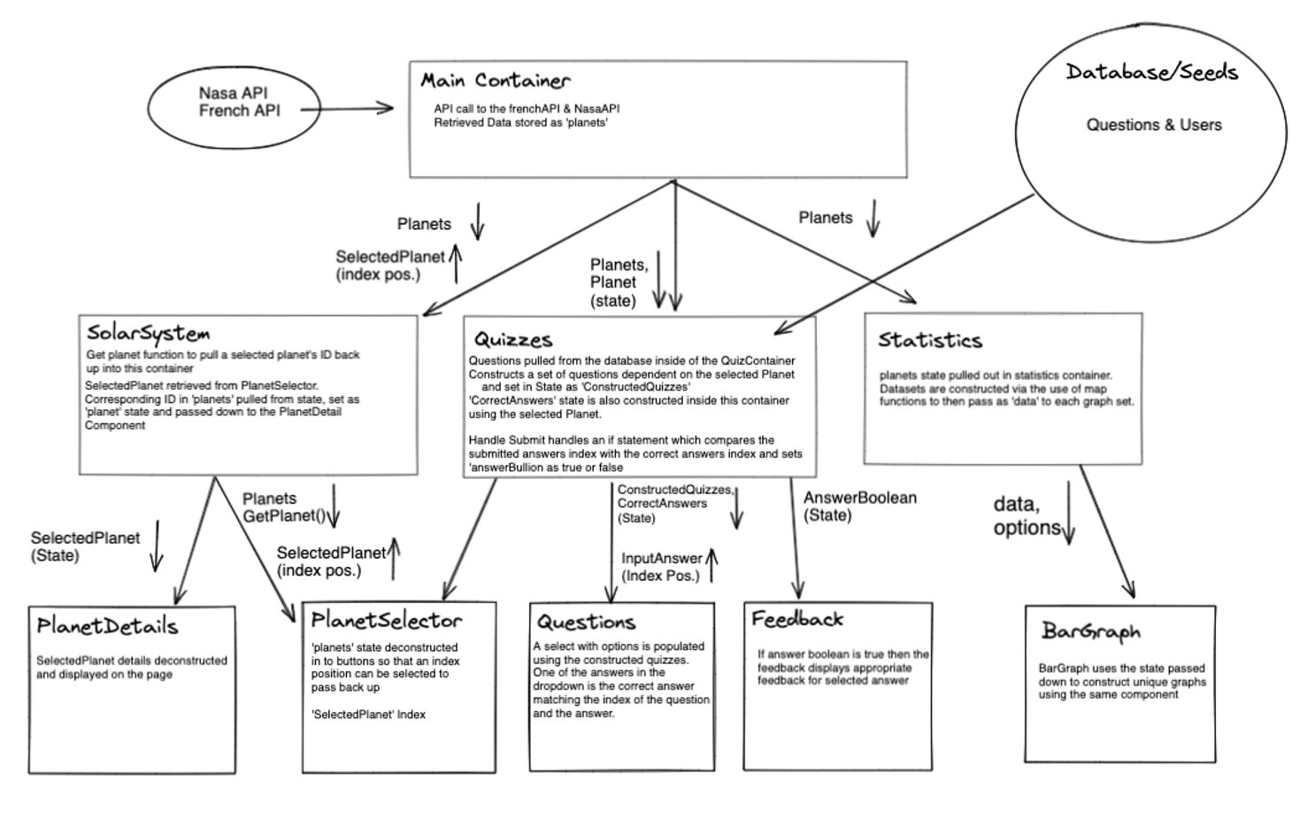
Notes:
(1m) _James

Slide 9
James

Slide 10
Quizzes Section
Collaborative effort (pair-programming)
Made full use of react State
Imported Database questions
Assembled correct answers using API, index positions and state.
Feedback uses state and logic comparison function to display appropriate visual feedback.
Code works well, it's scalable with a database and object edit to any number of questions.
Dynamicly build correct answers from API based on selected planet in state.
Can be expanded to every object in the solar system based on the API.

Slide 11
Layout section
Leverage react's capabilities
Styled Components
Used global styles
Splash page, independent style sheet due to complexity
Absoloute positioning within grid causes issues.
Techniques used.

Slide 12
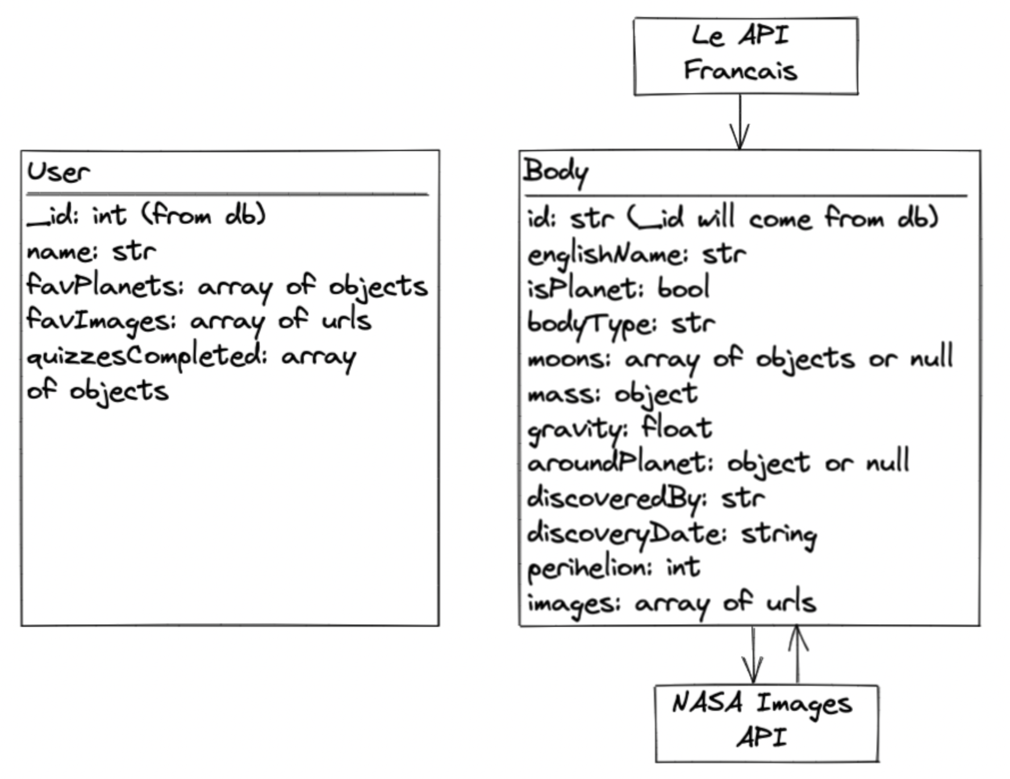
DB/server section
Used Insomina and MongoDB Compass to see how our backend works
Created seeds database where users/question info are saved
Initially, put external api data (e.g. planet information) in DB but instead made JS files where external APIs and local APIs (e.g. Question formats for quizzes) interact.

Slide 13
Reflections
Description object manually hard-coded in order to meet time-constraint - but database became dynamic
Add math render to quiz answers to populate a randomised list of wrong answers from the API.
In initial stages a variety of techniques were tried and some worked better than others, going forward now have a better idea of what works where.
Notes:
(2-3m)

Slide 14
Team retrospective
What we have learnt
If I knew then what I know now...
Being adaptive to changes and keeping sight of the project scope based on constraints.
If we had more time...
More APIs
Tie in existing DB functionality to unused front end.
Refactoring code to tidy
Added multiple choice answers to questions
Edits to graphs, more pages, rover details, more api info, expansion.
CSS to be a lot dryer, global styles refined, organise.
Notes:
(2-3m)

Slide 15
Conclusion ()
Notes:
That's the end of it. Do you have any questions?

Slide 16
Questions?

